Slide 1
Colorado Motor Vehicle Sales Report
By Madhumita Patro

Slide 2
About Dataset
Description
This dataset contains information on motor vehicle sales in various counties across
Colorado, segmented by year and quarter.
The data is useful for analyzing trends in vehicle sales, understanding the economic impact of automotive transactions, and making informed decisions in related business or policy planning.

Slide 3
Columns
● Year: The calendar year in which the sales data was recorded.
● Quarter: The quarter of the year during which the sales were made. The quarters
are divided as follows:
○ Q1: January to March
○ Q2: April to June
○ Q3: July to September
○ Q4: October to December
● County: The name of the county in Colorado where the sales were recorded.
● Sales: The total dollar amount of motor vehicle sales in the specified county and
quarter.

Slide 4
Use Cases
Economic Analysis: Track the economic health and trends in the automotive
market within Colorado.
● Market Research: Identify sales patterns and market demands in different
counties.
● Policy Making: Inform decisions on automotive industry regulations and
infrastructure planning.

Slide 5
Project Overview
Objective: To analyze motor vehicle sales data in Colorado to identify trends, forecast
future sales and understand the factors influencing sales.
Steps to Follow:
1. Define the Scope and Objective:
○ Identify the key metrics and objectives for the analysis (e.g., monthly sales
trends, sales by vehicle type, forecast future sales).
○ Define the time frame for the analysis.
2. Data Collection:
○ Gather motor vehicle sales data from reliable sources.

Slide 6
PROJECT OVERVIEW CONTINUED
3. Data Preparation:
○ Clean the data to remove any inconsistencies or errors.
○ Prepare the data for analysis using tools like Pandas.
4. Exploratory Data Analysis (EDA):
○ Perform EDA to understand the data distribution and identify patterns.
○ Use visualization tools like Matplotlib and Seaborn to visualize the data.
5. Statistical Analysis:
○ Perform statistical analysis to identify correlations and trends.
○ Use tools like Python (Pandas, Statsmodels) for this purpose.

Slide 7
PROJECT OVERVIEW CONTINUED
6. Predictive Modeling:
○ Build predictive models to forecast future motor vehicle sales.
○ Use machine learning algorithms like Linear Regression, ARIMA, or
SARIMA.
7. Reporting:
○ Summarize the findings in a comprehensive report.
○ Use visualizations to support the analysis and make the report more
engaging.

Slide 8
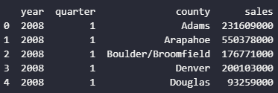
Step-by-Step Implementation
First few rows of dataset:

Slide 9
2. Data Preparation:
Convert date column to datetime format
Check for Missing Values
Fill or Drop missing values if necessary
Aggregate Sales by month

Slide 10
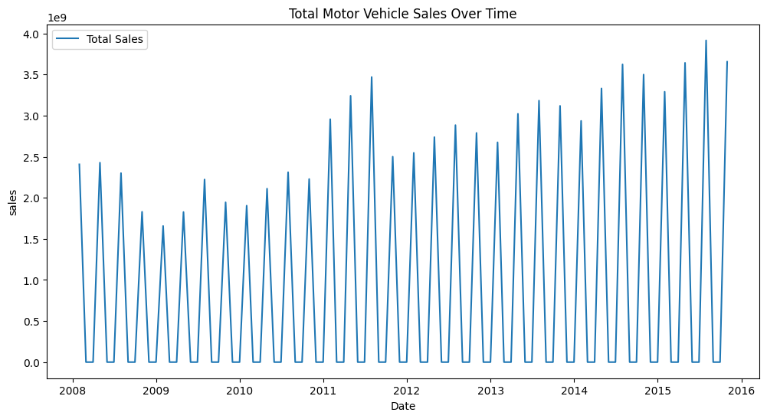
3. Exploratory Data Analysis (EDA):
Plot Total Sales over Time

Slide 11
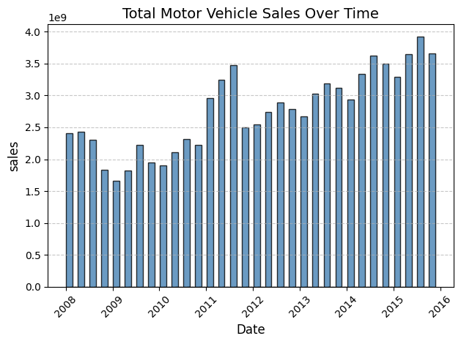
Sales Over Time – Bar Chart

Slide 12
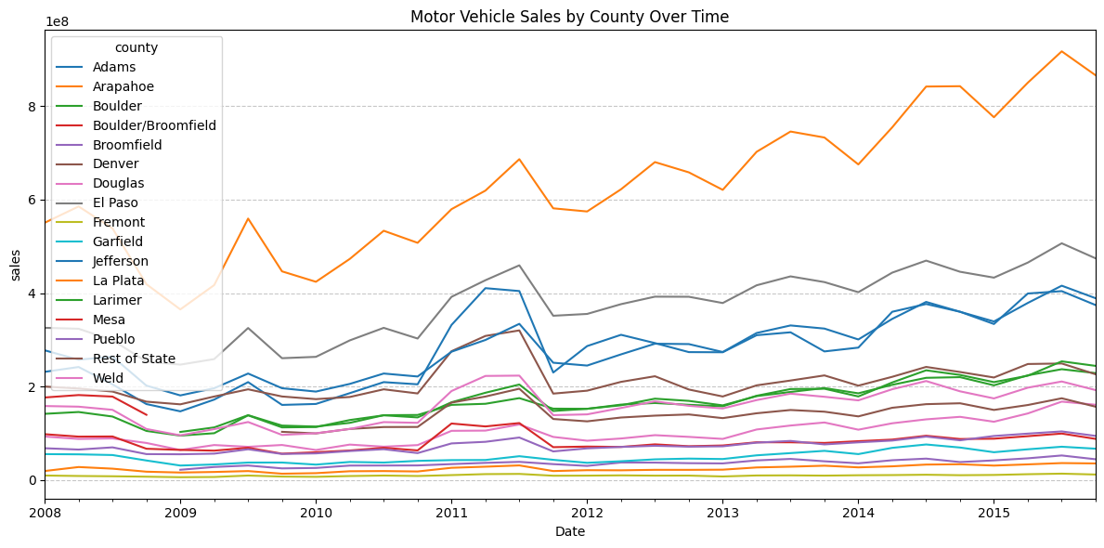
Sales by county level

Slide 13
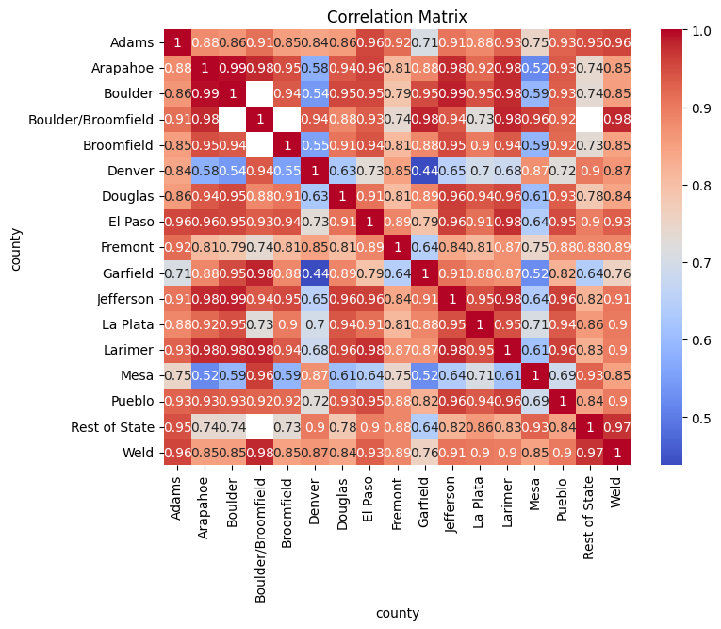
4. Statistical Analysis (a. Correlation matrix]

Slide 14
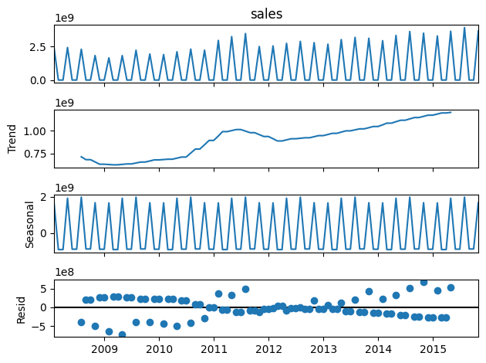
5. Predictive Modeling [using the additive model python]

Slide 15
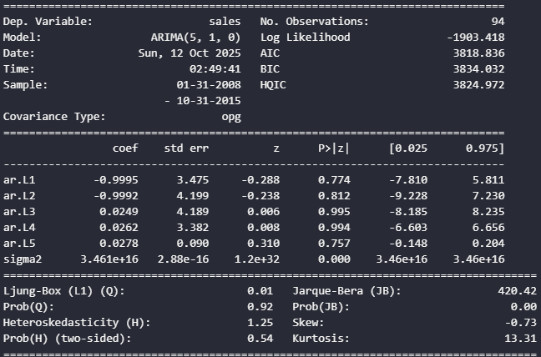
Arima model in python

Slide 16
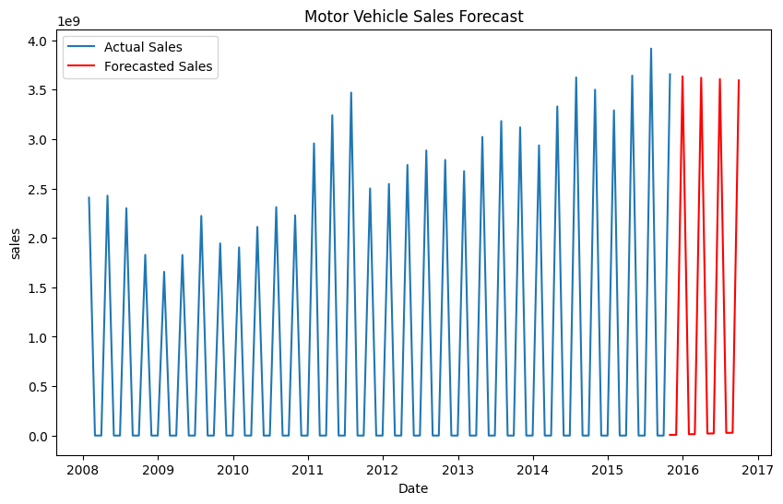
Sales predictions [python]

Slide 17
Mean squared error
Mean Squared Error: 1.8408355258317576e+16

Slide 18
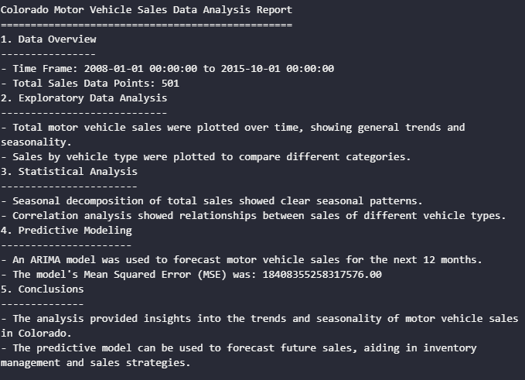
6. Reporting

Slide 19
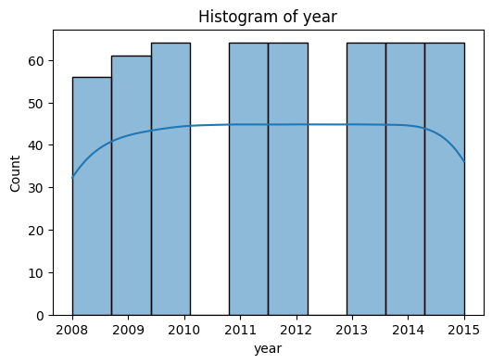
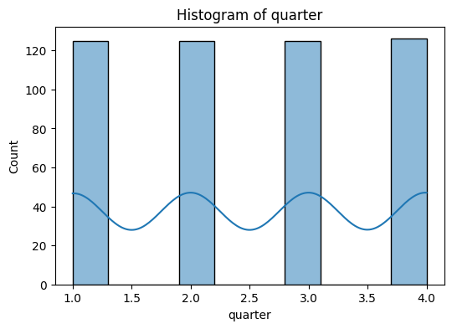
EDA using python matplotlib and seaborn

Slide 20
EDA USING python- matplotlib and seaborn

Slide 21
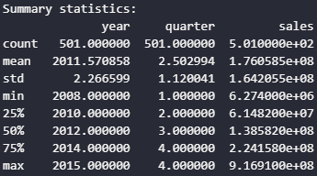
Summary statistics

Slide 22
EDA(using python, analysis of dataset)

Slide 23
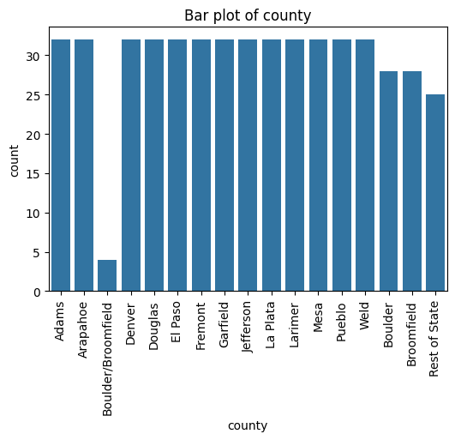
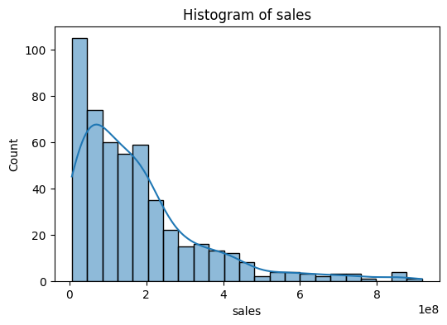
Eda continued

Slide 24
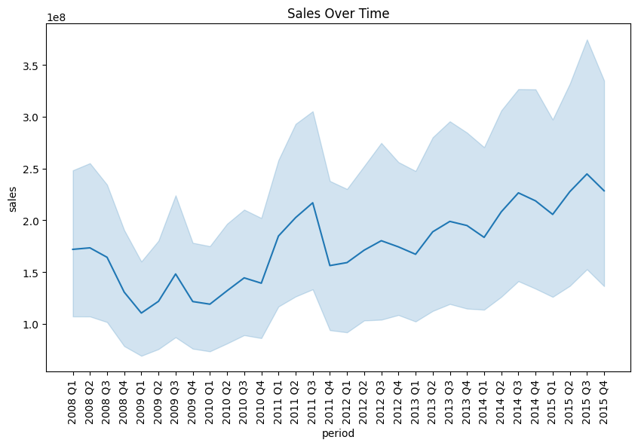
Sales over time plotted using python seaborn and matplotlib

Slide 25
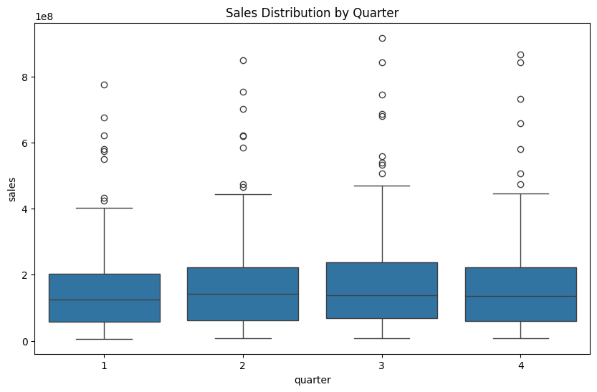
Sales by quarter in box plot

Slide 26
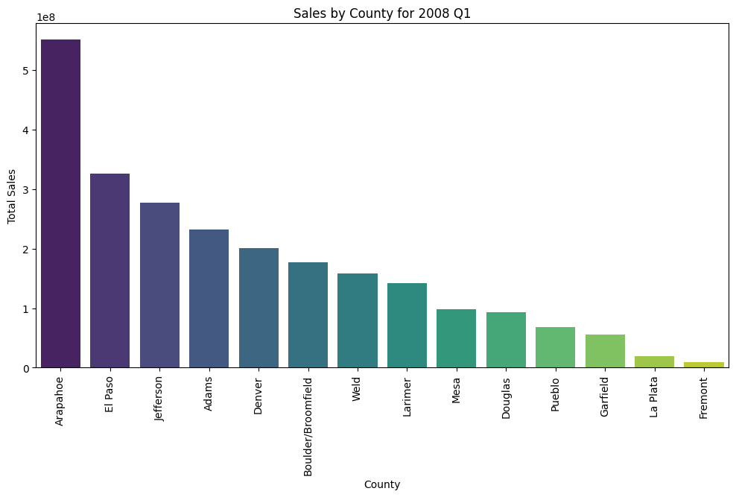
Start- Sales by year and quarter-1

Slide 27
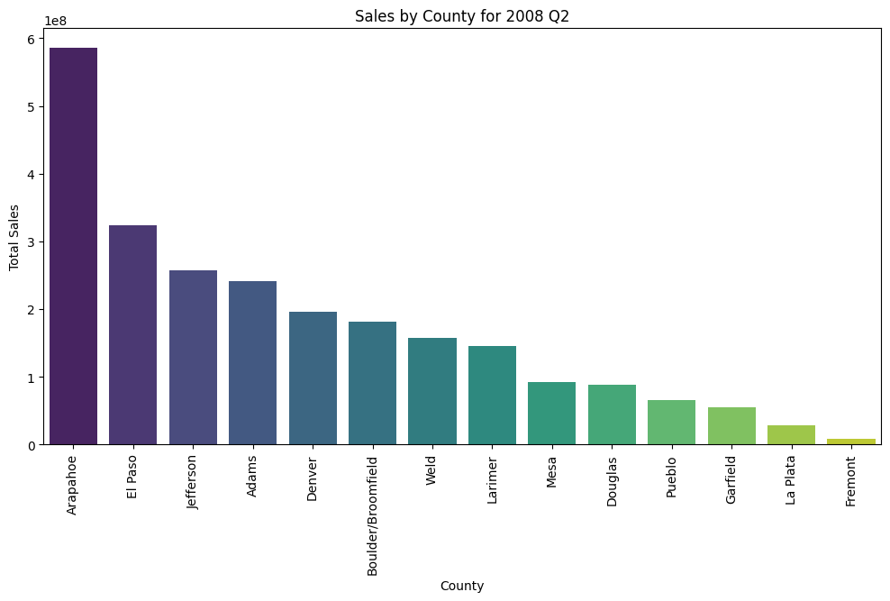

Slide 28
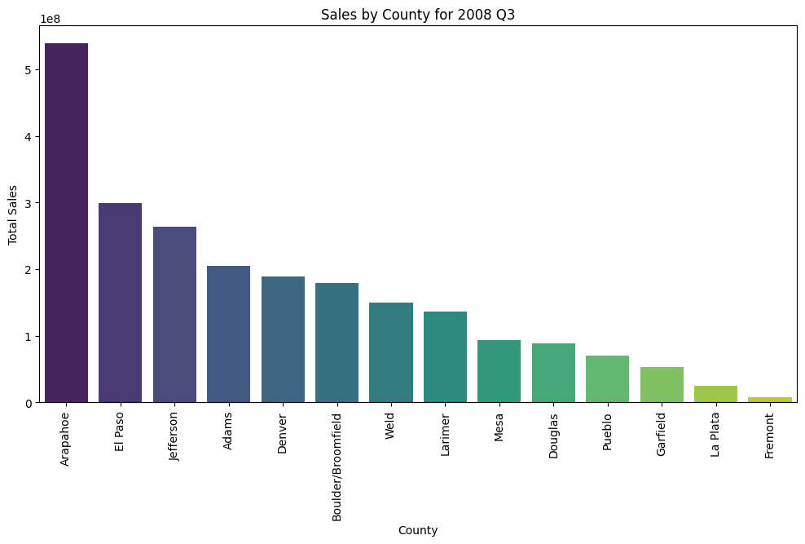

Slide 29
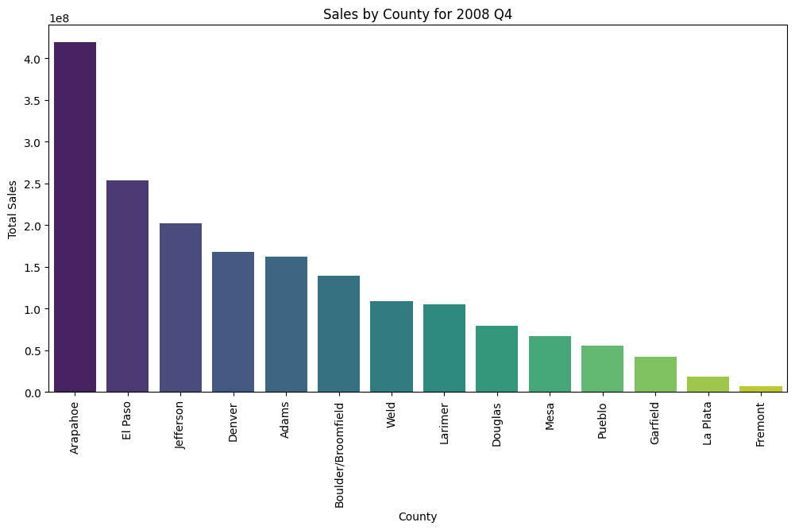

Slide 30
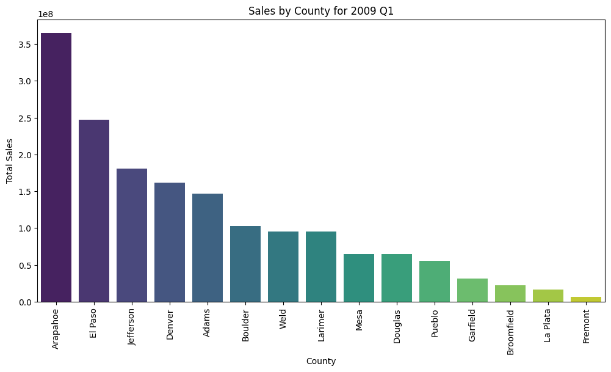

Slide 31
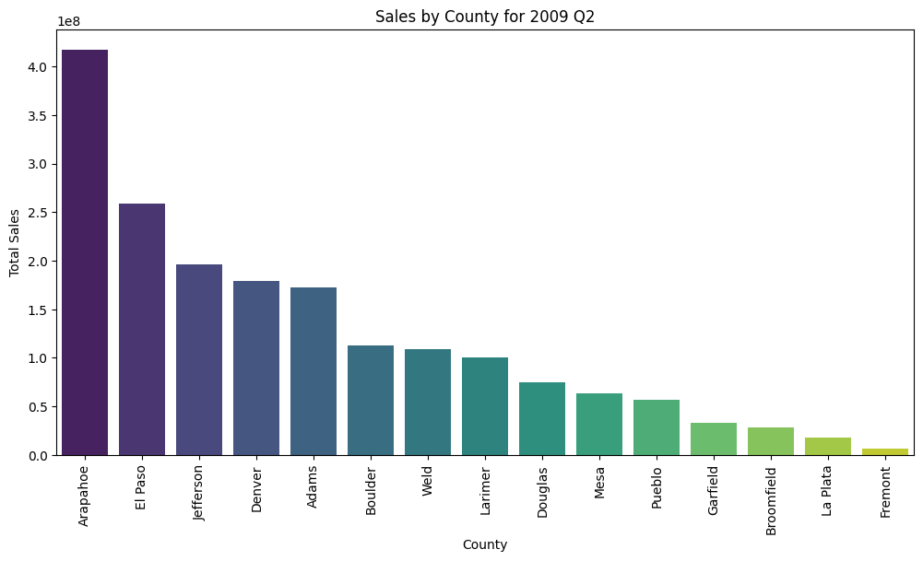

Slide 32
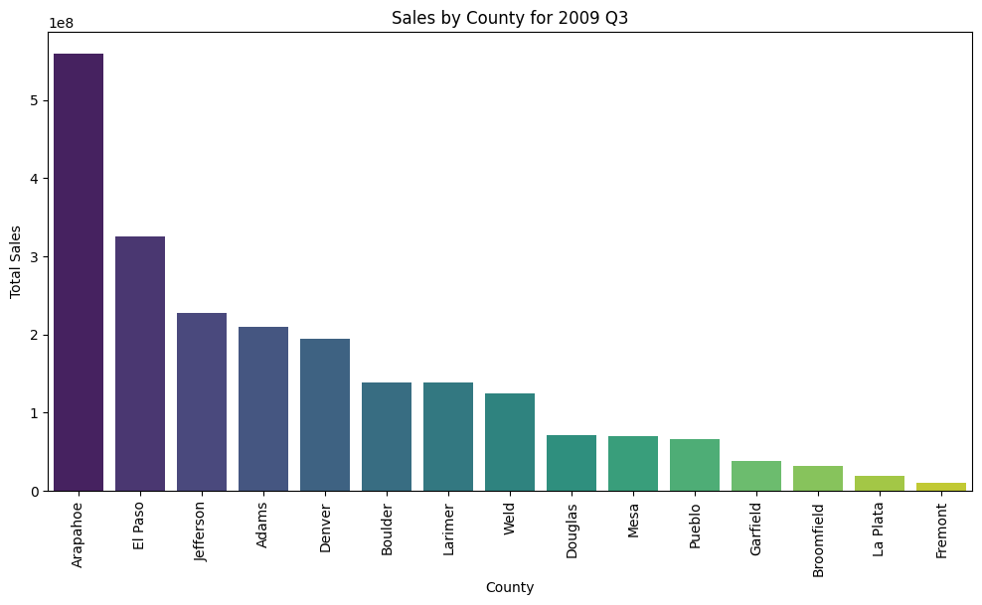

Slide 33
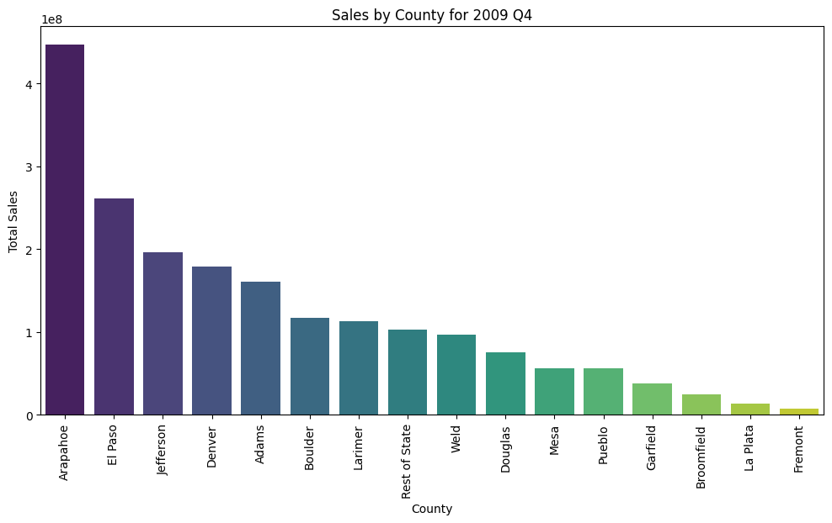

Slide 34
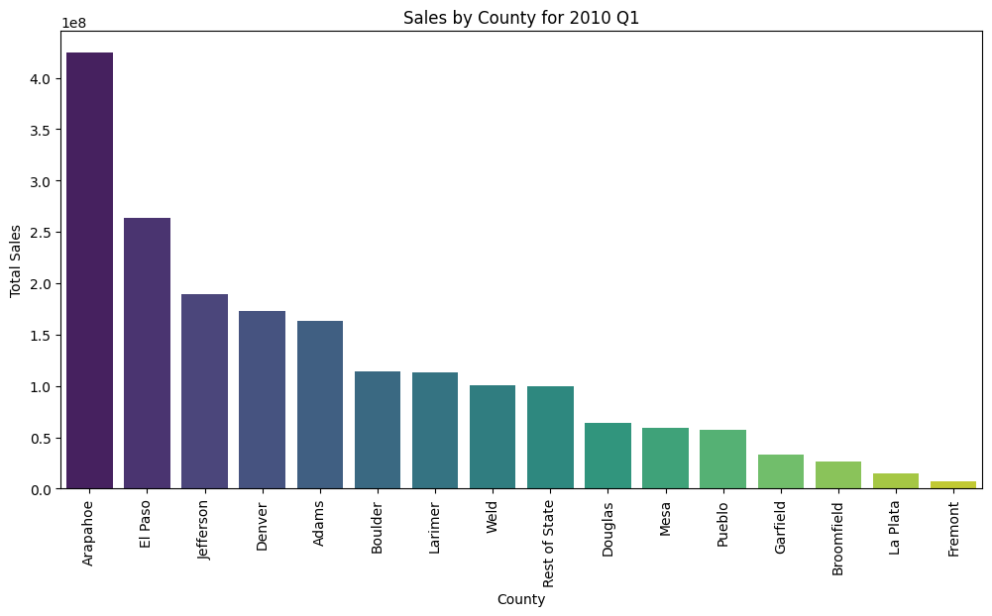

Slide 35
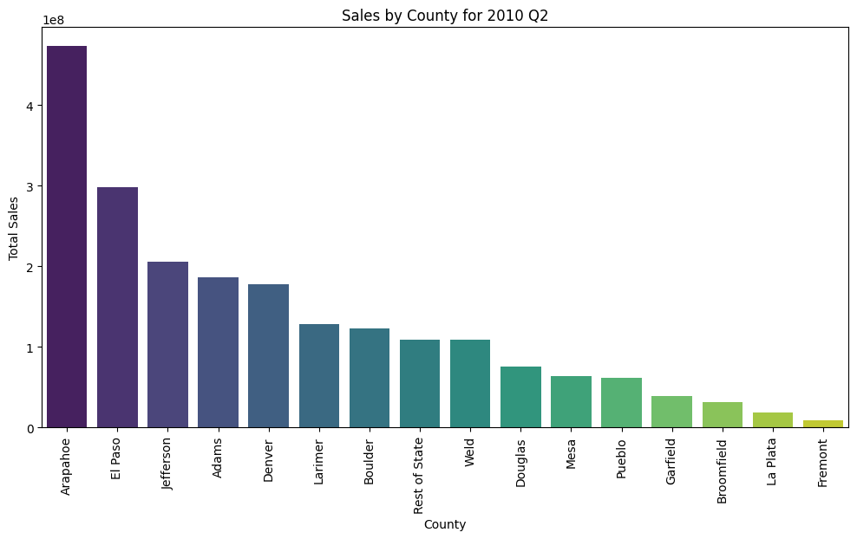

Slide 36
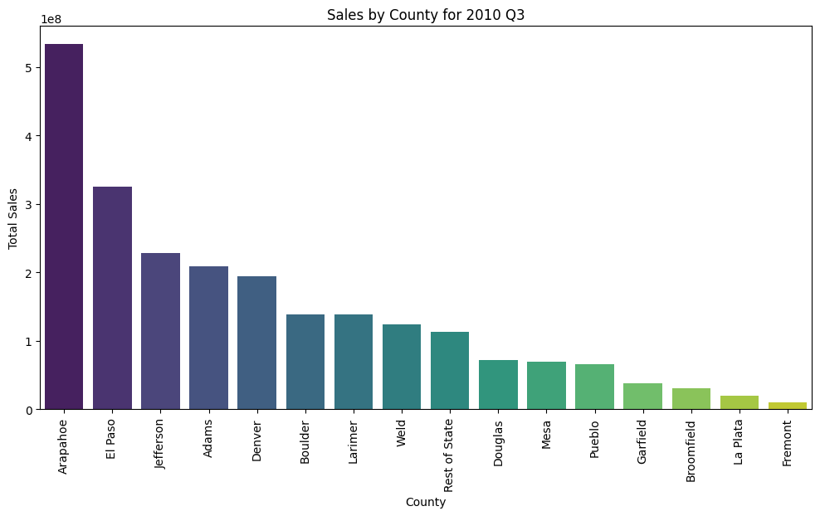

Slide 37
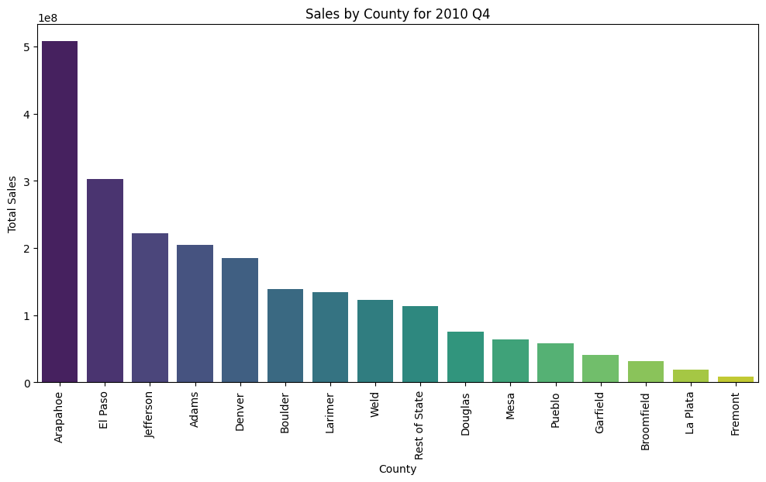

Slide 38
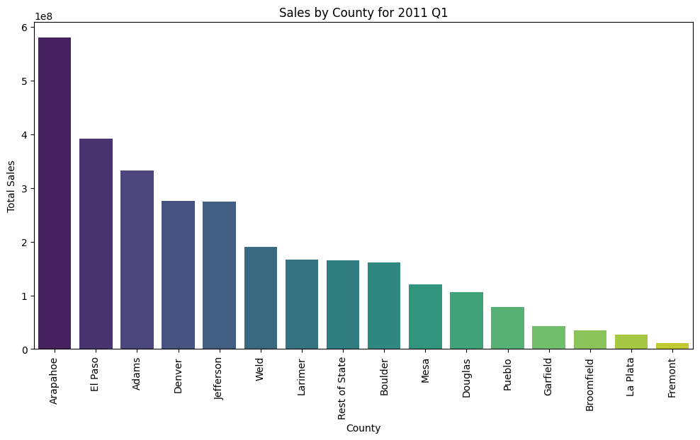

Slide 39
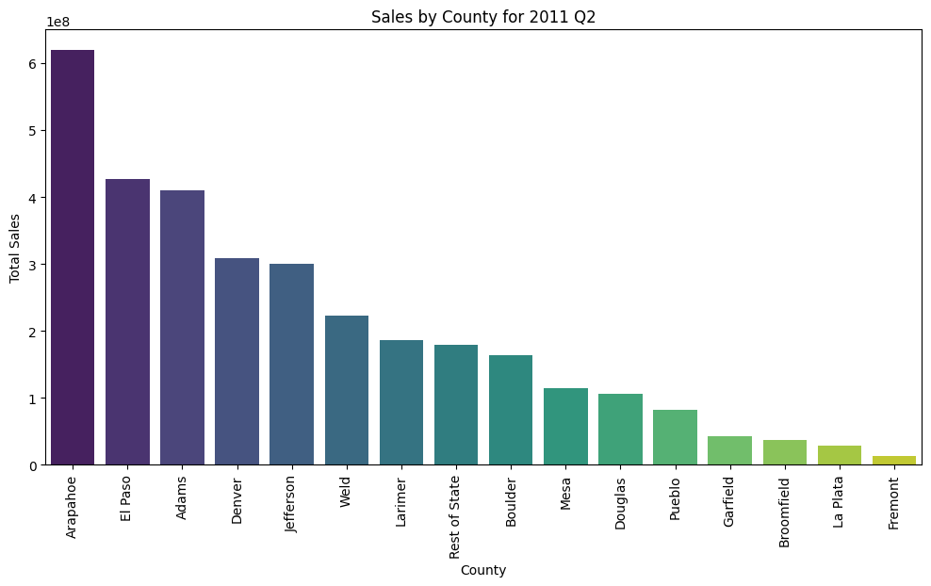

Slide 40
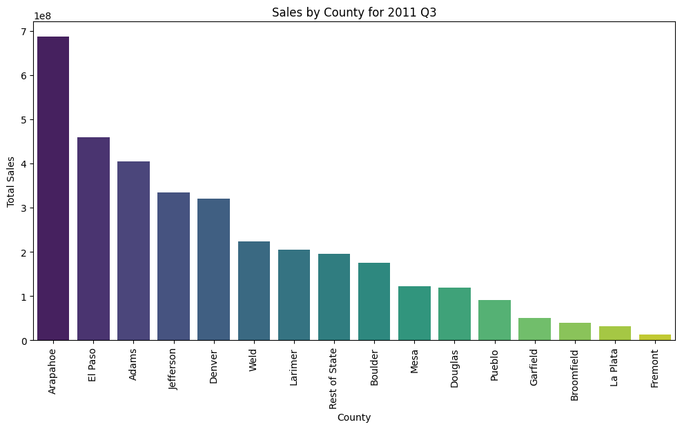

Slide 41


Slide 42


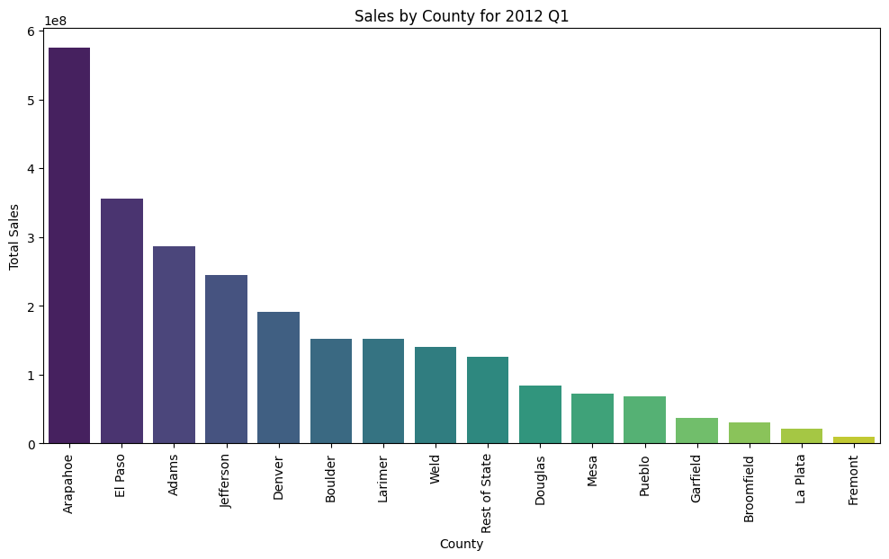

Slide 43


Slide 44
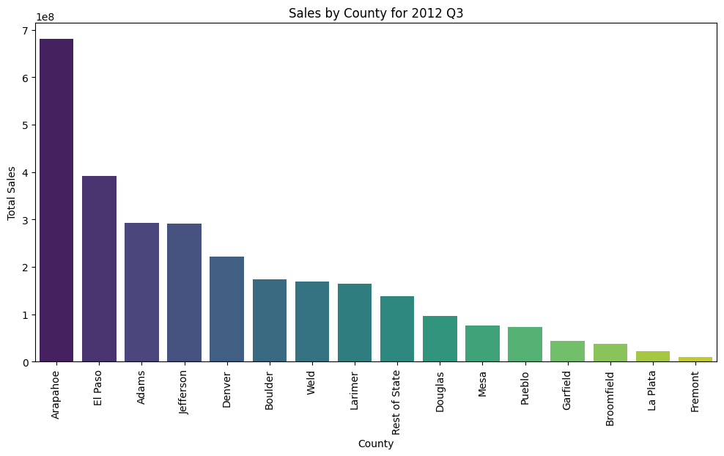

Slide 45
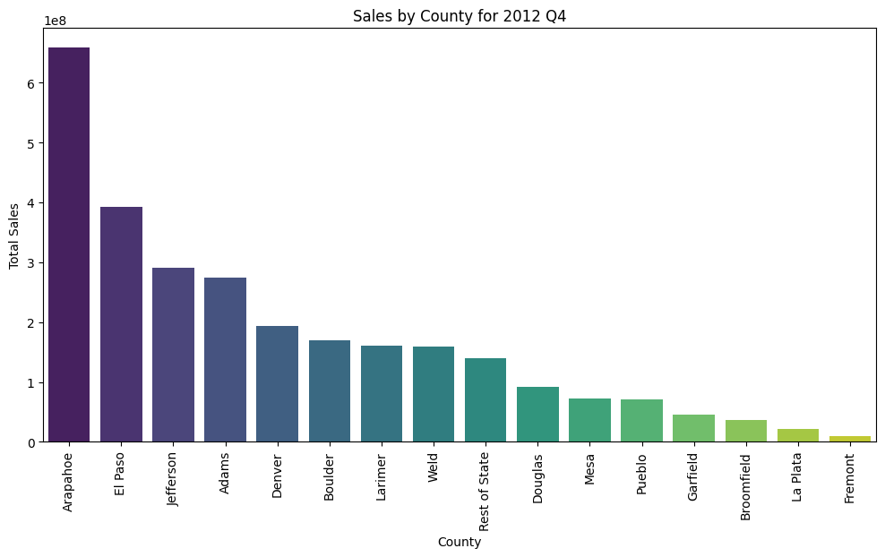

Slide 46
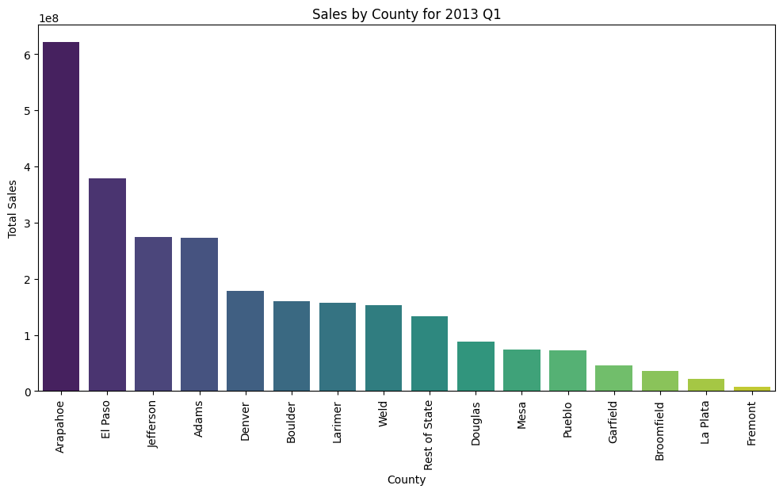

Slide 47
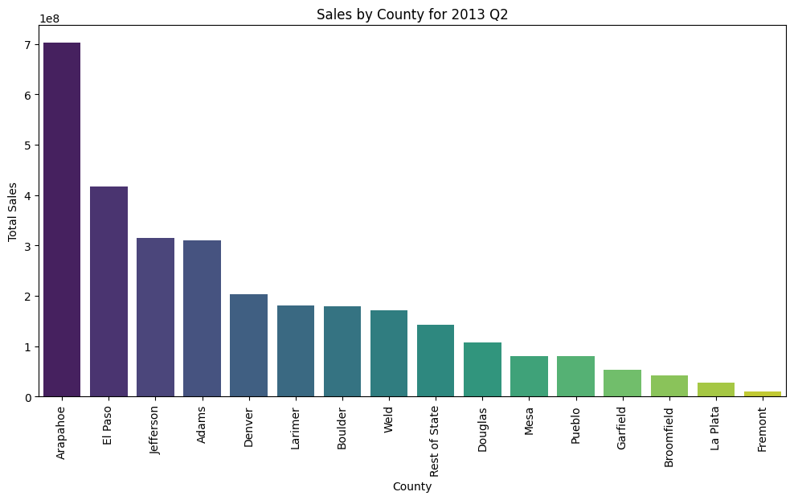

Slide 48


Slide 49


Slide 50


Slide 51


Slide 52


Slide 53
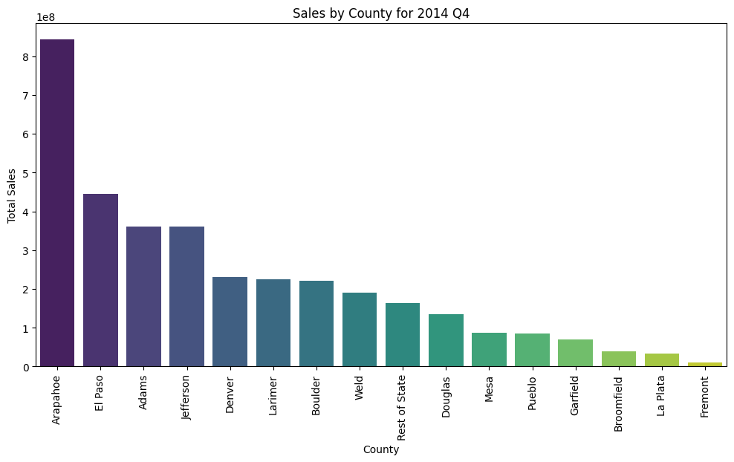

Slide 54
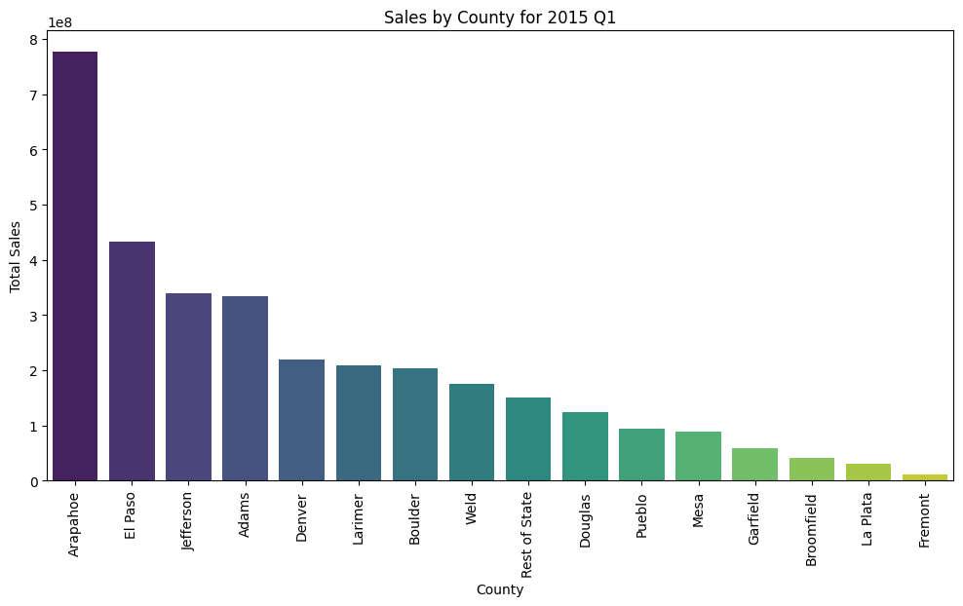

Slide 55


Slide 56


Slide 57


